Slide 1

Green Pace
Security Policy Presentation
Developer: Mason Voorhees

Slide 2

OVERVIEW: DEFENSE IN DEPTH
Here is a model to show what we follow to ensure we maintain security through out the development cycle.

Slide 3
THREATS MATRIX
Likely Threats that are more probable to happen | Priority Standard with high relevancy
Low priority Standard with low relevancy | Unlikely Threats that are less probable to happen
Secure coding standards have a system that ranks vulnerability to measure how much impact that standard has.

Slide 4
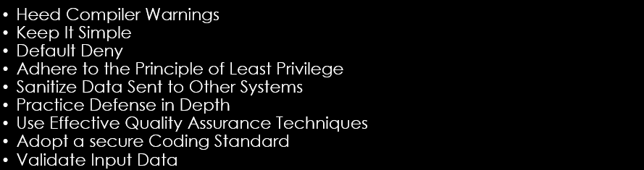
10 PRINCIPLES

Slide 5
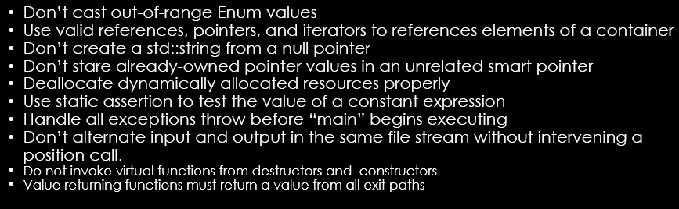
CODING STANDARDS

Slide 6
ENCRYPTION POLICIES
Encryption in rest: This type of encryption is designated to stop an attacker from obtaining files that are stored on the disk. Think of this like a vault. Its data that is in one spot that is secured and requires a lot of work to break the encryption to obtain the data if the encryption key is not given.
Encryption at flight: This type of encryption is designed to secure data being transmitted. Think of a connection to a remote server, all data being sent to that server needs to be encrypted and secure so that an attacker cannot intercept that information.
Encryption in use: This type of encryption is used to secure data in use such as data in ram. This is used so that all information being accessed at that moment where it is stored in ram is also encrypted. Compromising this level of encryption can allow the attacker to access an encryption key.

Slide 7
TRIPLE-A POLICIES
Authentication: Authentication is the process that allows a user to connect. They need to be given a green light to be allowed in. Think of a security guard that must check your ID before letting you in.
Authorization: Authorization is the amount of access each person has. Think of security clearance how there are levels to it. Only some people have access to certain information.
Accounting: Accounting is monitoring what is going on with every user. Think of a camera that watches overt employees. It allows us to know what everyone was doing, where, and what time.

Slide 8
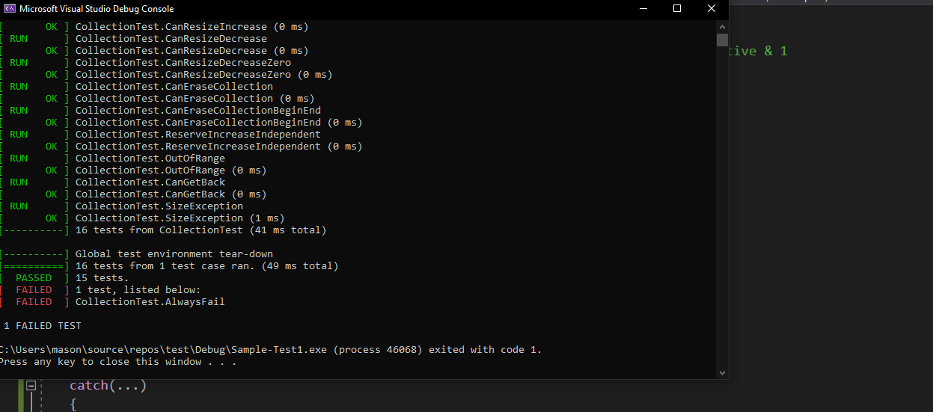
Unit Testing
Unit testing is something that is used early in the development cycle to make sure that everything is secure. This can be used to make sure SQL injection cannot occur, and many other tests to keep everything secure.

Slide 9

AUTOMATION SUMMARY

Slide 10
TOOLS
The DevSecOps pipeline is a method that allows the development of a project to efficiently keep code secure.
This cycle is very concrete. The only thing I would suggests to keep in mind is layered security like DiD. Always test during the cycle and not the end of the cycle. This will help detect vulnerabilities early on, so they do not linger on till the end causing bigger issues.

Slide 11
RISKS AND BENEFITS
When programming we always have risks. We need to always assume the worst and prepare for it. We need to stay on top of always making sure the security of the system is outstanding. Educating our selves in new ways attacks can be made on a system, allows us to prepare for them ahead of time which will benefit us greatly.

Slide 12
RECOMMENDATIONS
Stay on top of security
Keep up with new methods attackers use
Keep everything clean
Try to make everything simple
Unit test code
Don’t wait till the end to test

Slide 13
CONCLUSIONS
The principles and standards mentioned above allows us to conclude what is needed to develop and sustain a secure software development life cycle. We also need to remember that a all things outside the company network needs to be treated as classified information to ensure security.

Slide 14
REFERENCES
“Confluence.” SEI CERT Coding Standards - CERT Secure Coding - Confluence, wiki.sei.cmu.edu/confluence/display/seccode/SEI+CERT+Coding+Standards.
Singh, Jas. “Why Is Secure Coding Important? (ESSENTIAL INFO).” Cyber Security Kings, 28 July 2021, cybersecuritykings.com/2020/12/14/why-is-secure-coding-important-essential-info/.

